Slide 1
Teamwork
Creighton Rudolph and Spencer Ross

Slide 2
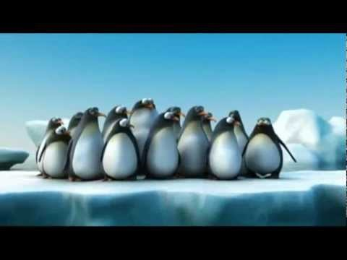
Teamwork Video

Slide 3
Questions on Teamwork
How did the penguins show teamwork? What would have happened if they didn’t?
How did the ant team know to save their friend?
So what is the common theme with all of the videos?
They all moved in a group to one side of the ice berg, so they would not get hurt.
They had a leader directing them.
It’s smarter to do things in groups.

Slide 4
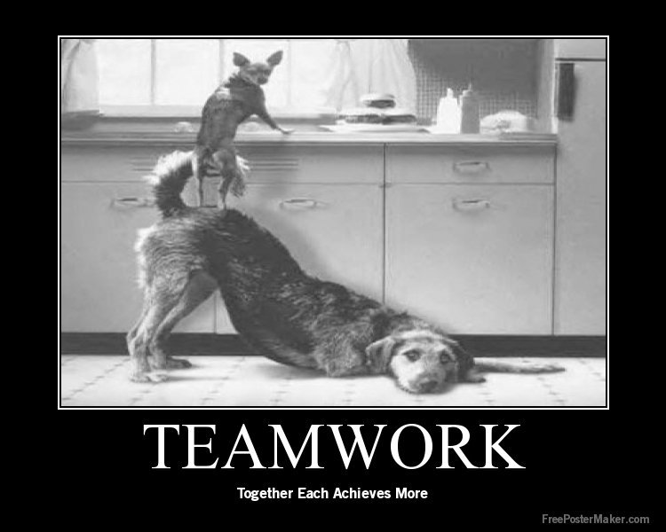
What is teamwork to you?
how a group of people work together to achieve a common goal

Slide 5
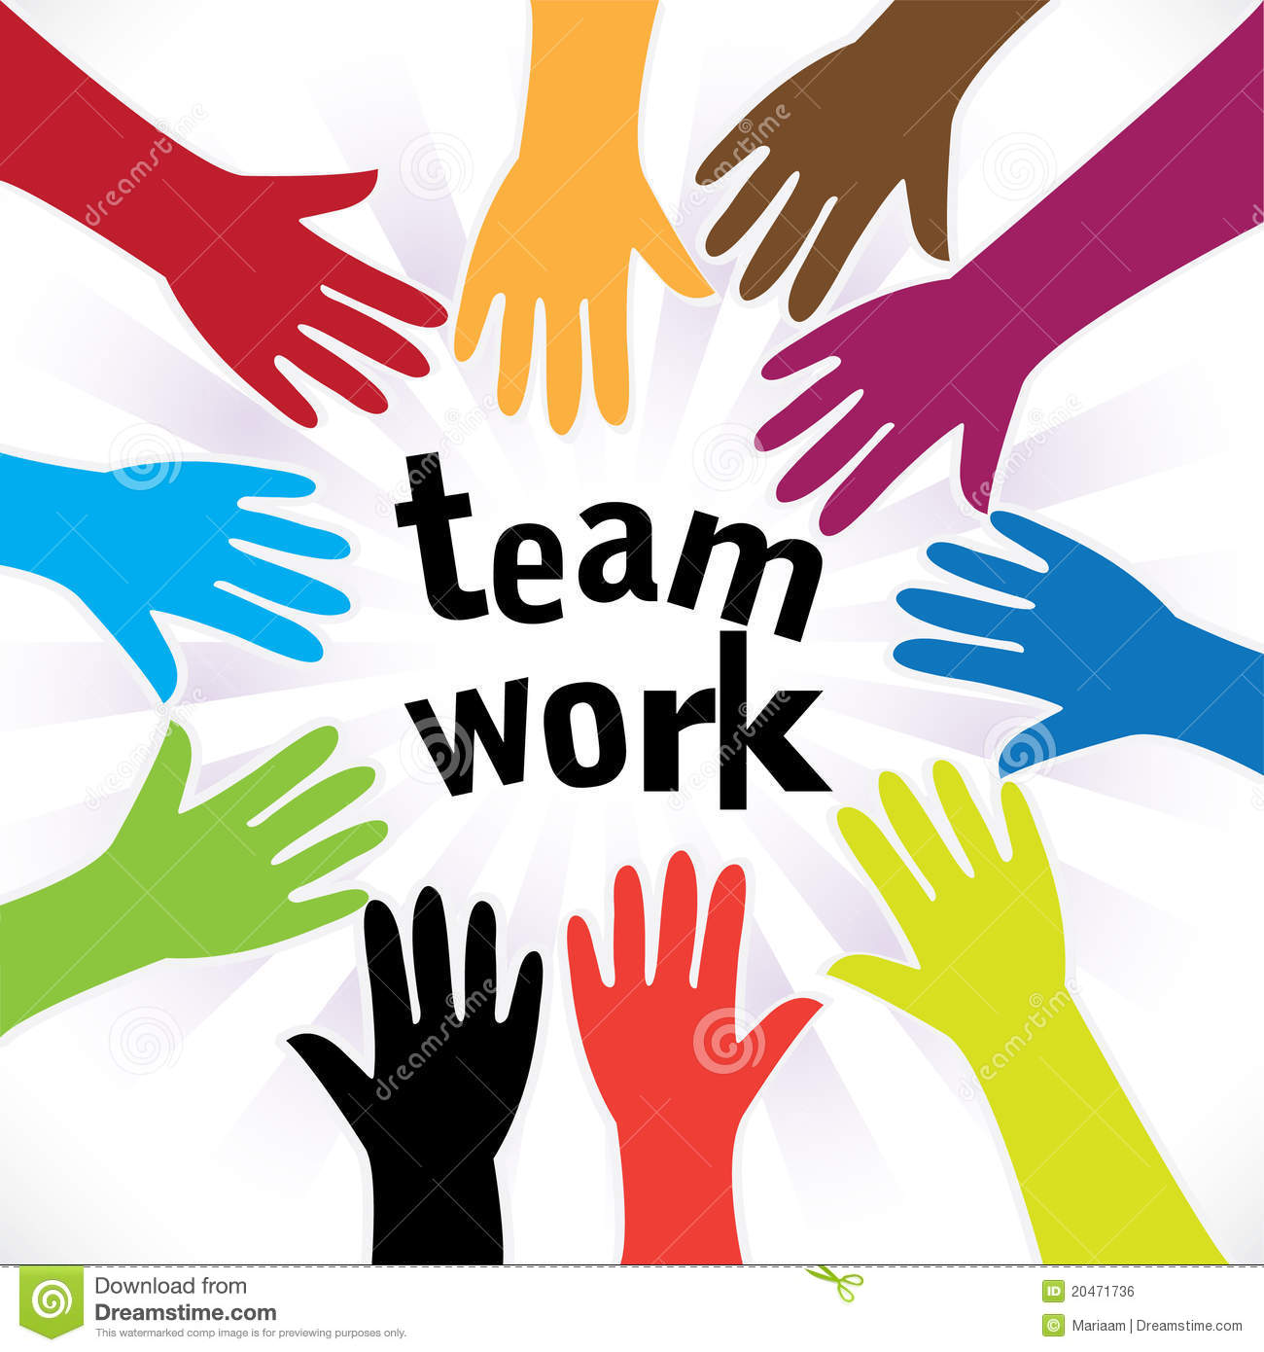
Teamwork and Business
Why is teamwork beneficial in business?
Achieve your goals faster
Be more productive in your company
Generate more and better ideas
Meet new people
Improves communication skills

Slide 6
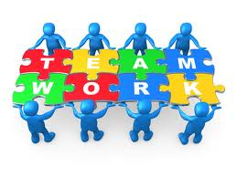
When and how can you use teamwork?
Can use it at:
School
Home
Church
Games
Make sure to hear and listen to everybody’s ideas
Include everybody in your group
Have fun

Slide 7
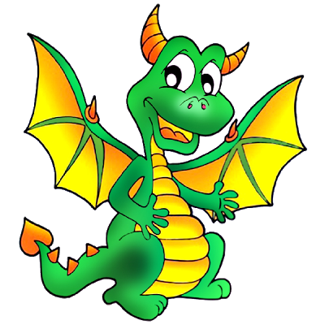
Don’t Wake The Dragon
Divide up into two teams
NO TALKING!!
Line up according to height from shortest to tallest
Talking=Waking the dragons
The dragon will stop you for 5 seconds
First team to line up correctly and say Boo! gets candy

Slide 8
Don’t Wake The Dragon
Divide up into two new teams
One person can talk!
Line up according to height from shortest to tallest
Talking=Waking the dragons
The dragon will stop you for 5 seconds
First team to line up correctly and say Boo! gets candy

Slide 9
Don’t Wake The Dragon
Divide up into two new teams
Everyone can talk!
Grab a dragon name
Line up in alphabetical order A-Z with the name you grabbed
First team to line up correctly and say Boo! gets candy

Slide 10
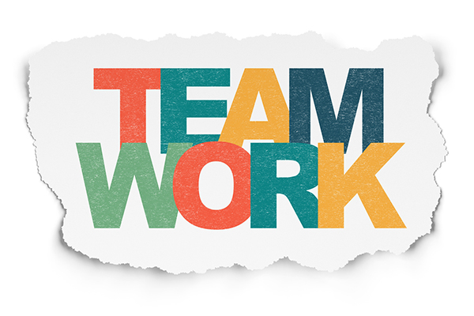
How does Don’t Wake The Dragon relate to teamwork?
Work together to try line up correctly
Couldn’t talk so it was extra difficult
Ability to work with a group is a great skill to have

